Slide 1
Getting Started with Openshift

Slide 2
Agenda
Openshift Overview
How to Deploy sample application in Openshift.
CI/CD demo in openshift.

Slide 3
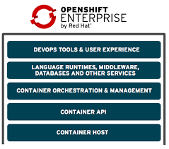
What is Openshift?

Slide 4

Openshift: overview . A container orchestration platform based on Kubernetes . Adds features that facilitate hosting of web applications

Slide 5
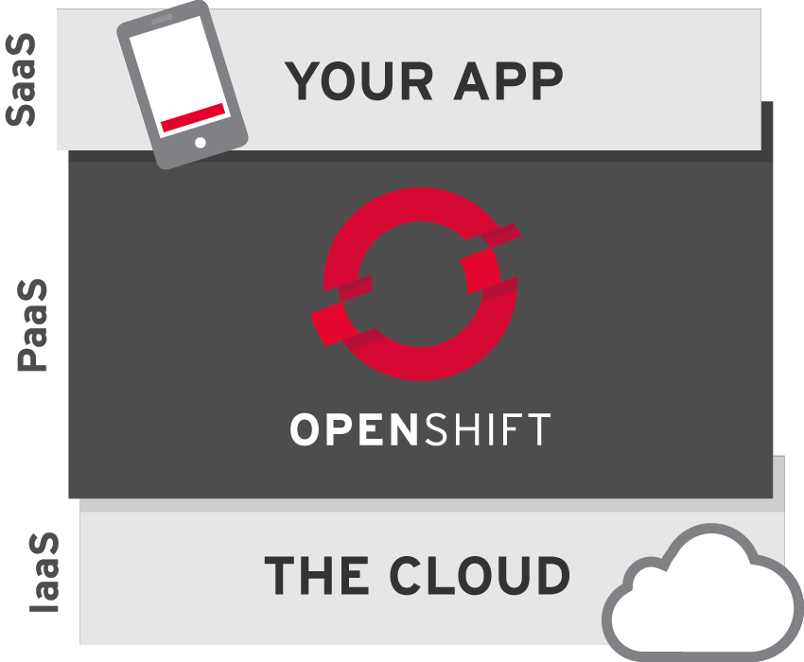
Iaas, Paas and Saas

Slide 6
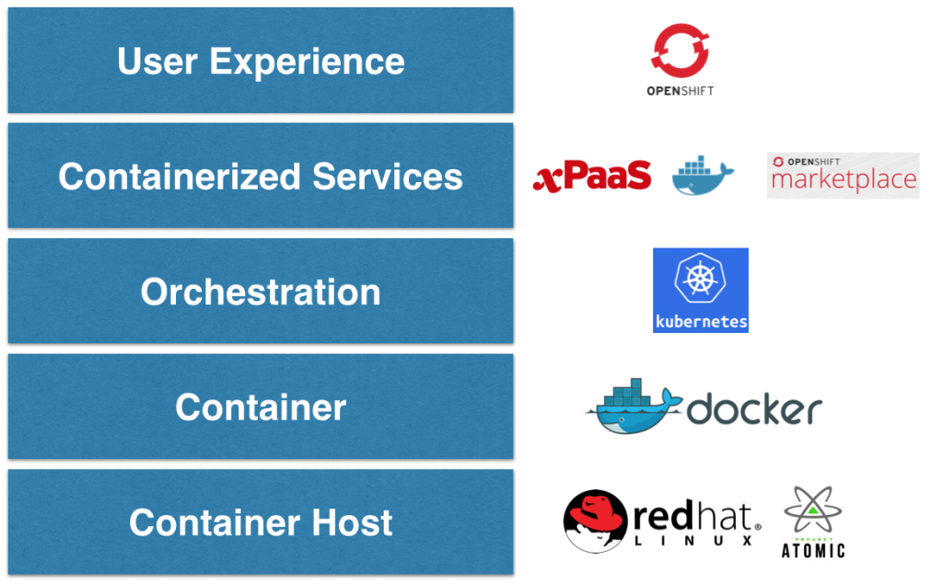
Paas Architecture

Slide 7
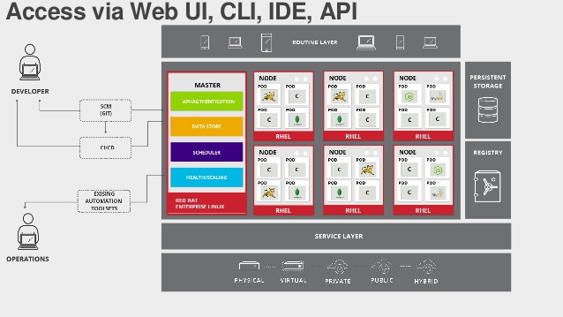
Openshift Architecture

Slide 8
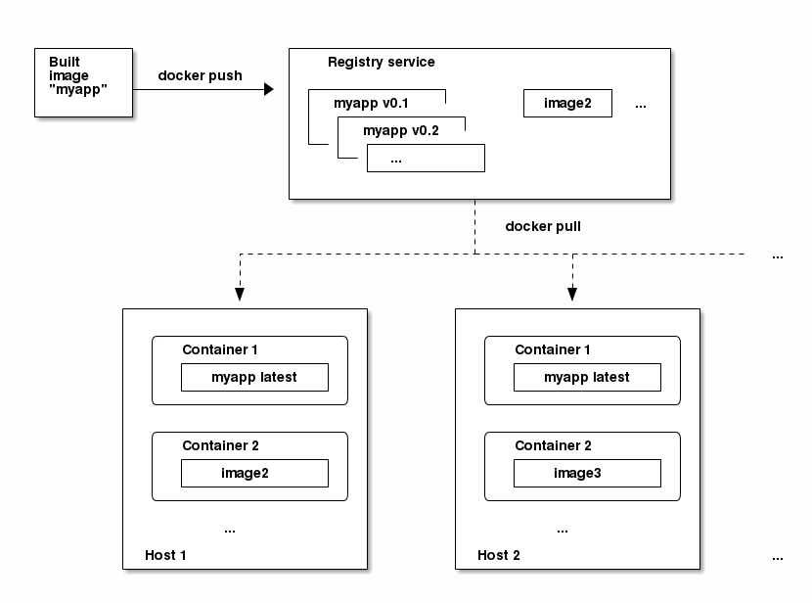
Docker Workflow

Slide 9
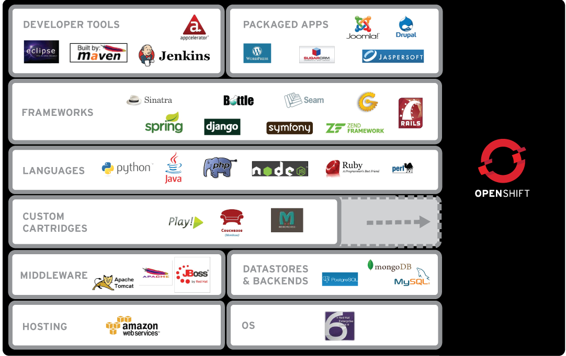
What’s supported?

Slide 10
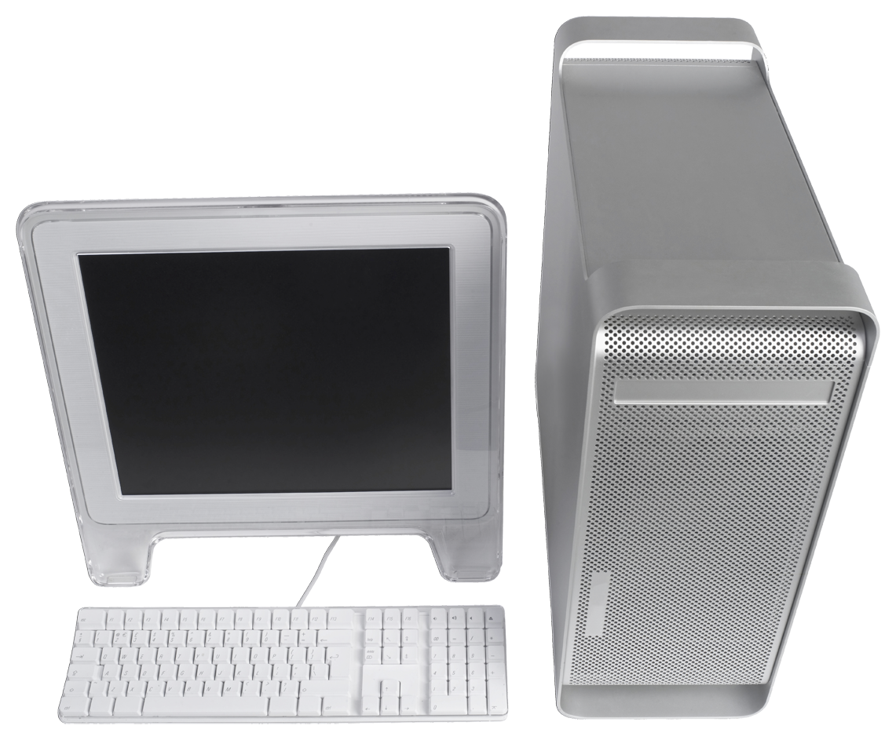
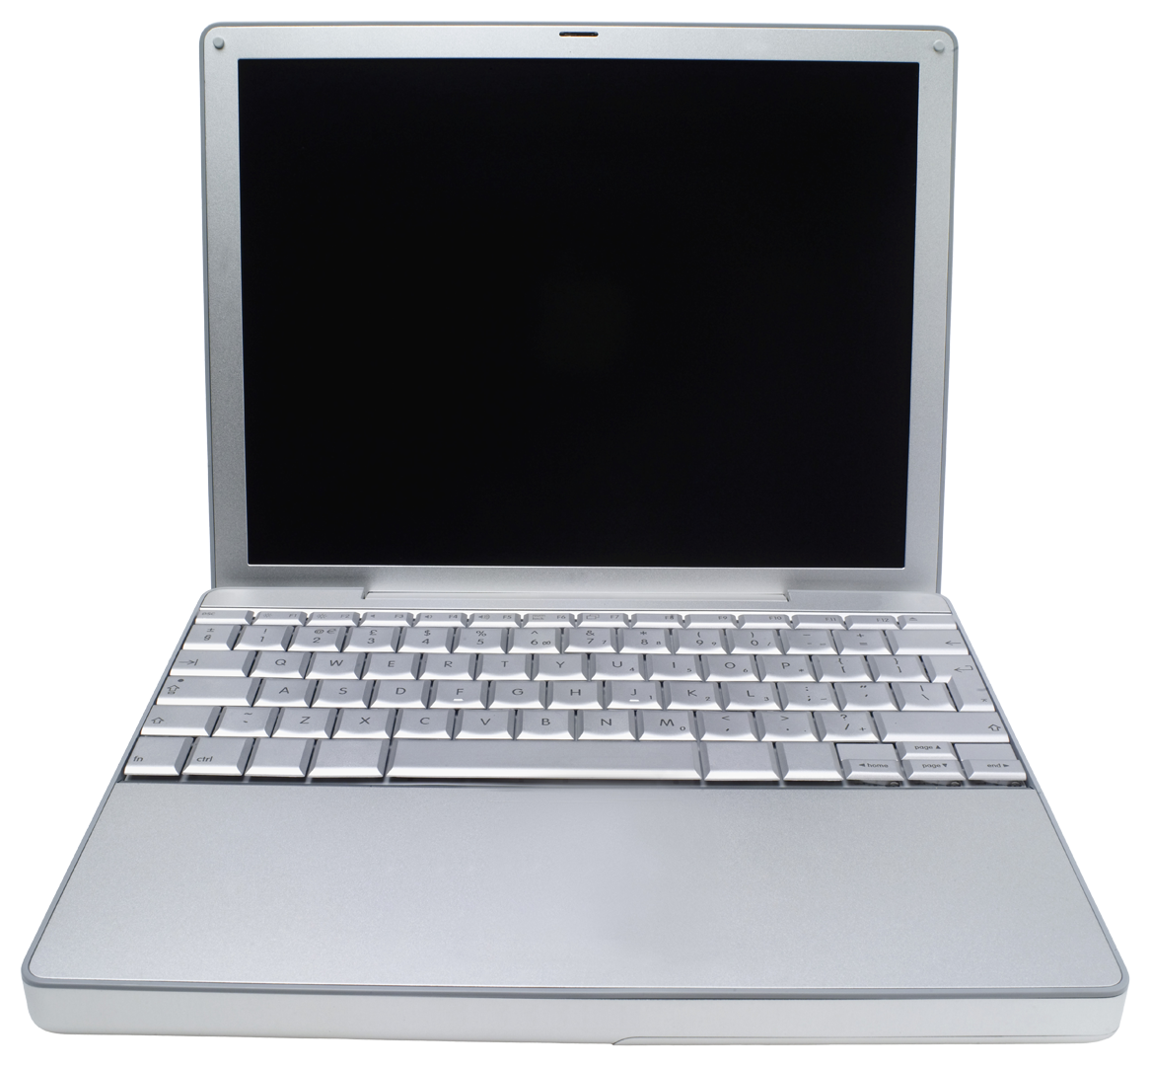

Deploy an Application in Openshift
Your laptop
Your OpenShift gear
1. Git clone
2. Write your code
3. Git commit and git add
4. Git push
Local Repository
Remote Repository

Slide 11
Actual commands to use
Your laptop
1. Git clone <your git url>
Your OpenShift gear
2. Write your code
3. For existing files: git commit –am “ your message” For new files: git add .
4. Git push
Local Repository
Remote Repository

